Slide 1
ADT Inc.
Leading Professional American Security
Company for Home Solutions
Proposed Take-Private by Apollo
Dated - October 2025
Subscription-based security platform with predictable cash flows supporting leveraged ownership.

Slide 2
Transaction Overview
Metric | Values
Target | ADT Inc.
Sponsor | Apollo Global Management
Transaction Type | Leverage Buyout
Enterprise Value | $9.0 bn
Entry Multiples | 8.5 x LTM EBITDA
Consideration | All-Cash
Financing | Debt + Sponsor Equity
Closing | Subject to Financing & Approval
Transaction: Apollo take-private of ADT
Enterprise Value: $4.5bn (3.9x LTM EBITDA)
Financing: ~65% debt / ~35% equity
Hold Period: 5 years
Base-Case Returns: ~12% IRR | ~1.75x MOIC
ADT represents a highly predictable, subscription-based cash flow business well-suited for leveraged ownership.

Slide 3
Highly predictable, subscription-driven cash flow business.
ADT | Values ( $ bn)
Revenue | $6.3
EBITDA | $1.05
EBITDA Margin | 17 %
Free Cash Flow | $600 m
Leading U.S. Residential & Small Business Security Platform
6mm monitored subscribers with long-term contracts
Recurring monthly revenue with low churn
Mission-critical service → non-discretionary demand
Revenue visibility and cash conversion are core strengths.

Slide 4
Non-cyclical demand supports downside protection
Favorable Long-Term Industry Tailwinds
Rising residential security concerns
Shift toward professionally monitored solutions
Bundling of security + smart-home services
Demand is non-discretionary and resilient across cycles.

Slide 5
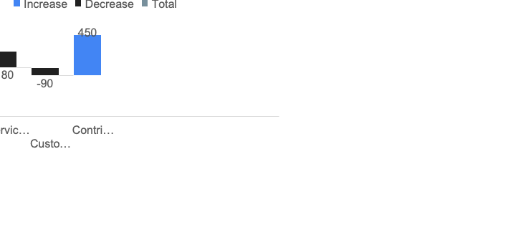
Subscription Economics
Metric | Value
% Recurring Revenue | 90% +
Average Monthly Revenue / User | $58
Annual Churn | 13%
Customer Lifetime Value | High
Subscription economics support high leverage and rapid deleveraging.
High cash conversion enables rapid debt amortization in early years.

Slide 6
Apollo value creation driven by cash flow, not growth multiple expansion
Apollo’s Value Creation Plan
Defensive cash flows — subscription revenue supports leverage
Operational efficiency — churn reduction and SG&A discipline
Deleveraging — free cash flow drives equity value creation
Disciplined exit — multiple supported by improved credit profile
This is a risk-adjusted return deal, not a growth gamble.

Slide 7
Sources & Uses
Sources ($bn) | Amount
Senior Secured Debt | $5.5
Subordinated / PIK Debt | $1.5
Sponsor Equity | $2.0
Total Sources | $9.0
Uses ($bn) | Amount
Equity Purchase | $8.5
Fees & Expenses | $0.5
Total Uses | $9.0
Senior Debt: $5.5 bn
Subordinated Debt: $1.5 bn
Appollo Equity: $2.0 bn
Conservative equity check with strong downside protection.
Capital structure sized to maximize equity returns while preserving covenant headroom.

Slide 8
Pro Forma Capital Structure
Instrument | Amount ($bn) | Multiples
Total Debt | 7.0 | 6.7 x EBITDA
Equity Value | 2.0
Total EV | 9.0 | 8.5 x
Leverage is high but supported by stable cash flows.

Slide 9
Operating Projections & Deleveraging
Year | EBITDA($bn) | Net Debt($bn)
Entry | 1.05 | 7.0
EBITDA | 1.20 | 5.0
EBITDA Margin | 1.35 | 3.5
Equity value creation driven primarily by deleveraging.
Net debt reduced from ~7.0bn at close to ~$0.3bn by exit, driving equity value creation.

Slide 10
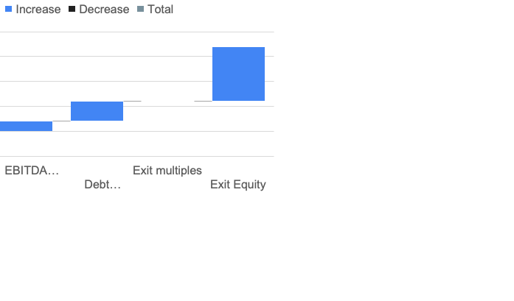
Returns & Sensitivity
Metrics | Value
Exit Multiples | 8.5 x
Holding Period | 5 Years
IRR | 18-20%
MOIC | 2.3 x
Entry at 3.9x EBITDA
Modest EBITDA growth
Exit at 7.5x EBITDA → equity uplift
Equity Returns driven by deleveraging and subscription cash Flows.
Exit multiple expansion reflects improved credit profile, materially lower leverage, and increased predictability of cash flows following multi-year deleveraging.

Slide 11
Risk & Mitigants
Key Risks
Customer churn higher than expected
Competitive pricing pressure
Technology disruption
High leverage
Mitigants
Long-term contracts
Strong brand and scale
Subscription visibility
Deleveraging profile
Risks are known, measurable, and manageable.

Slide 12
Proceed with take-private: stable cash flows, leverage capacity, and downside protection
Why This Works
Highly predictable subscription revenue
Strong downside protection
Multiple levers for value creation
Attractive risk-adjusted equity returns
ADT represents a classic Apollo take-private opportunity combining stability, leverage capacity, and disciplined value creation.

